Slide 1
AE + GAN
李晓宇
2019.12.18

Slide 2

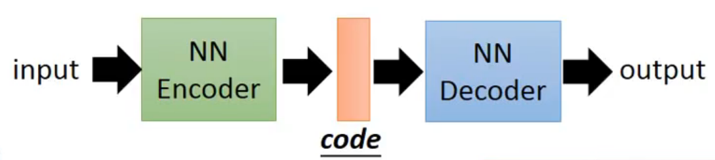
Auto-Encoder(AE)

Slide 3
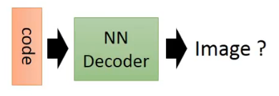
Auto-Encoder(AE)

Slide 4
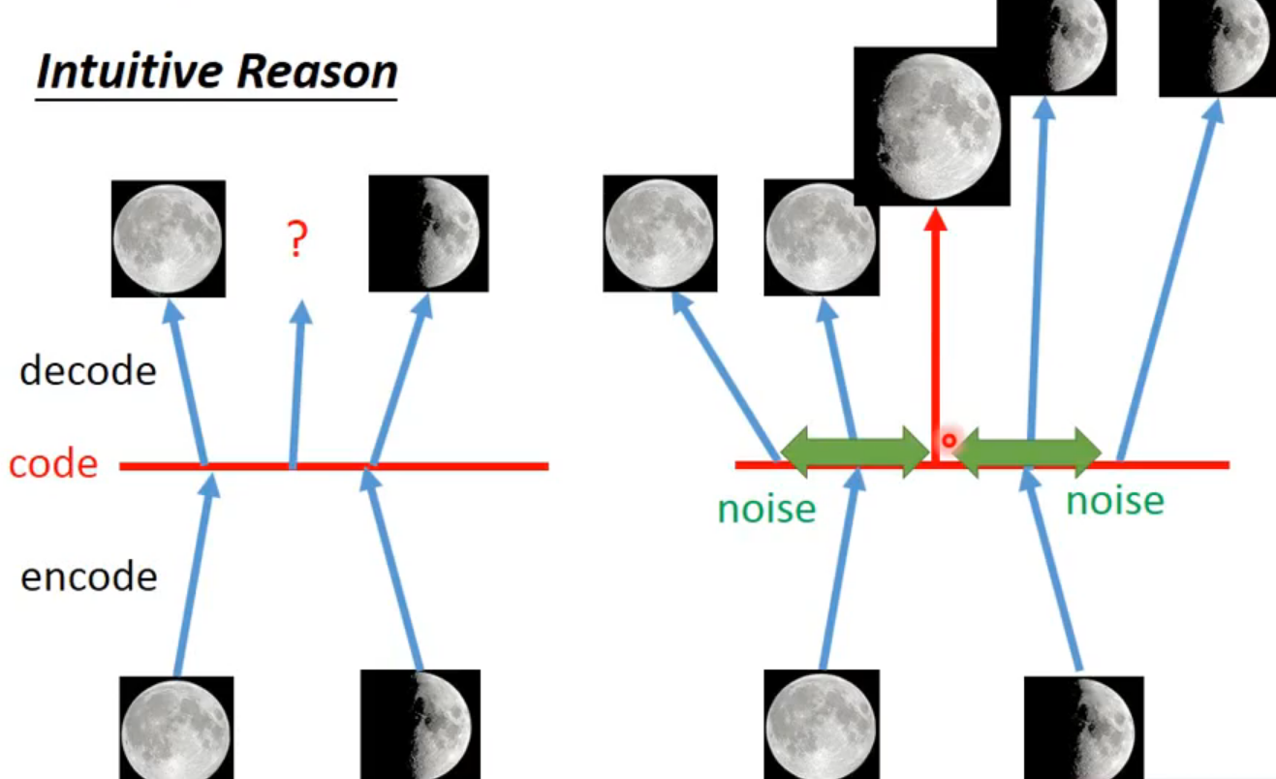
AE -> VAE

Slide 5
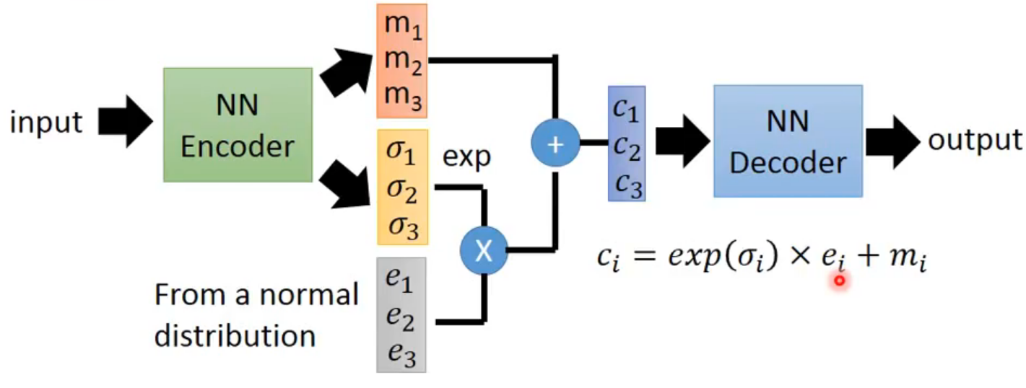
Vatiational Auto-Encoder (VAE)

Slide 6
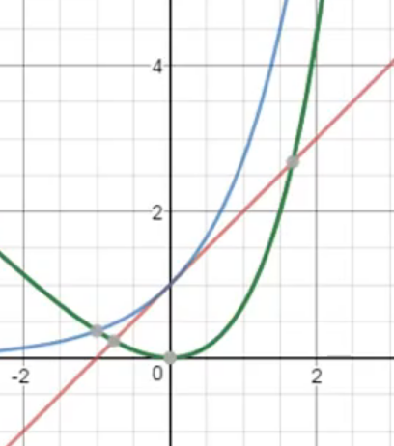
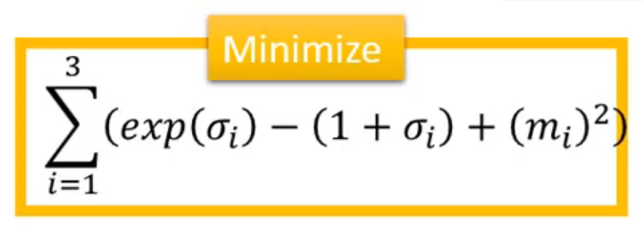
Vatiational Auto-Encoder (VAE)

Slide 7
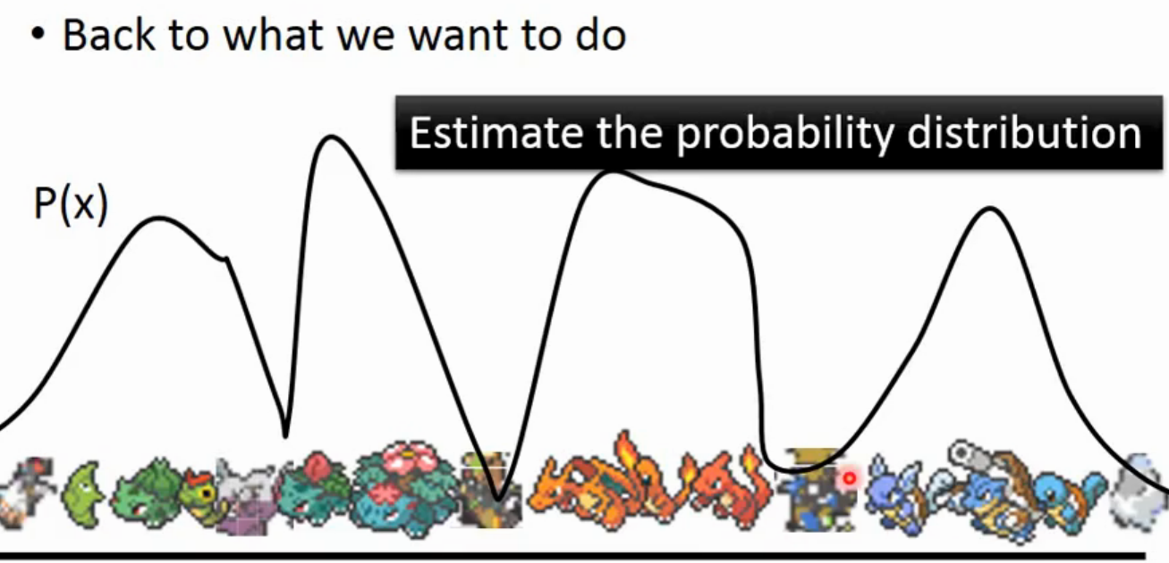
Vatiational Auto-Encoder (VAE)

Slide 8
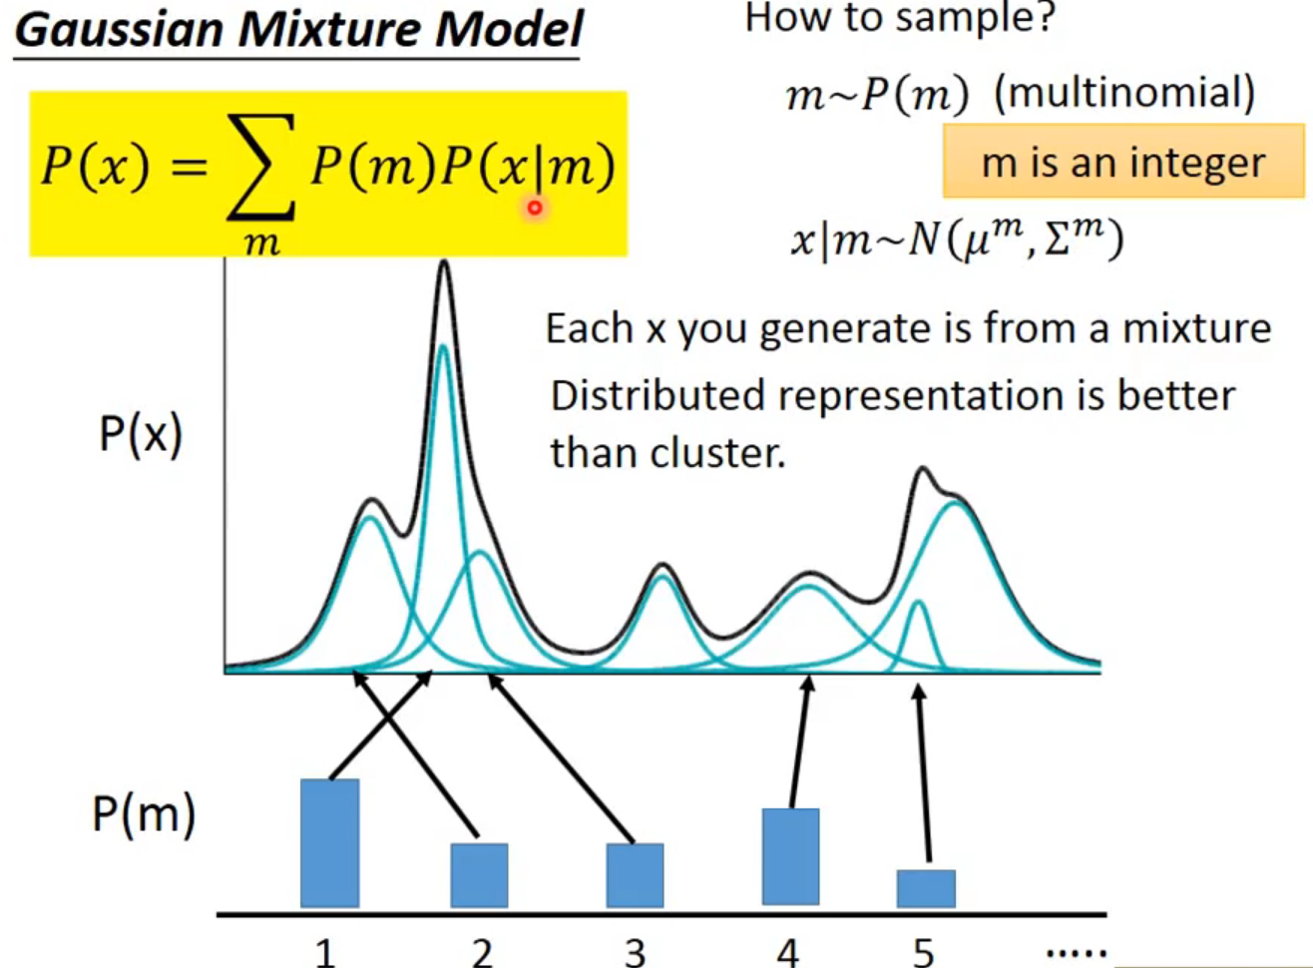
Vatiational Auto-Encoder (VAE)

Slide 9
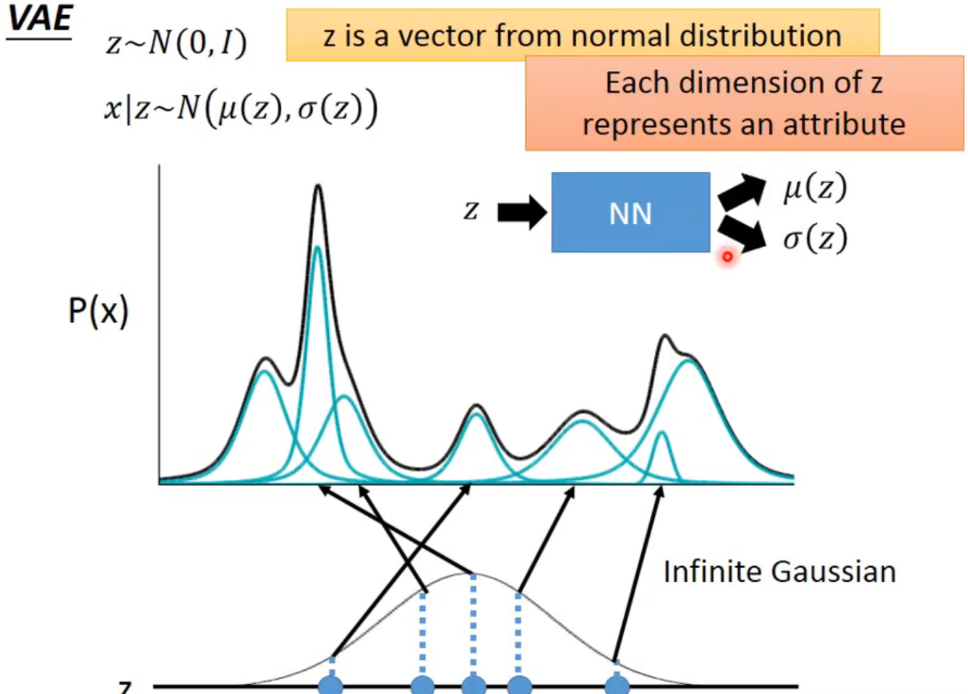
Vatiational Auto-Encoder (VAE)

Slide 10
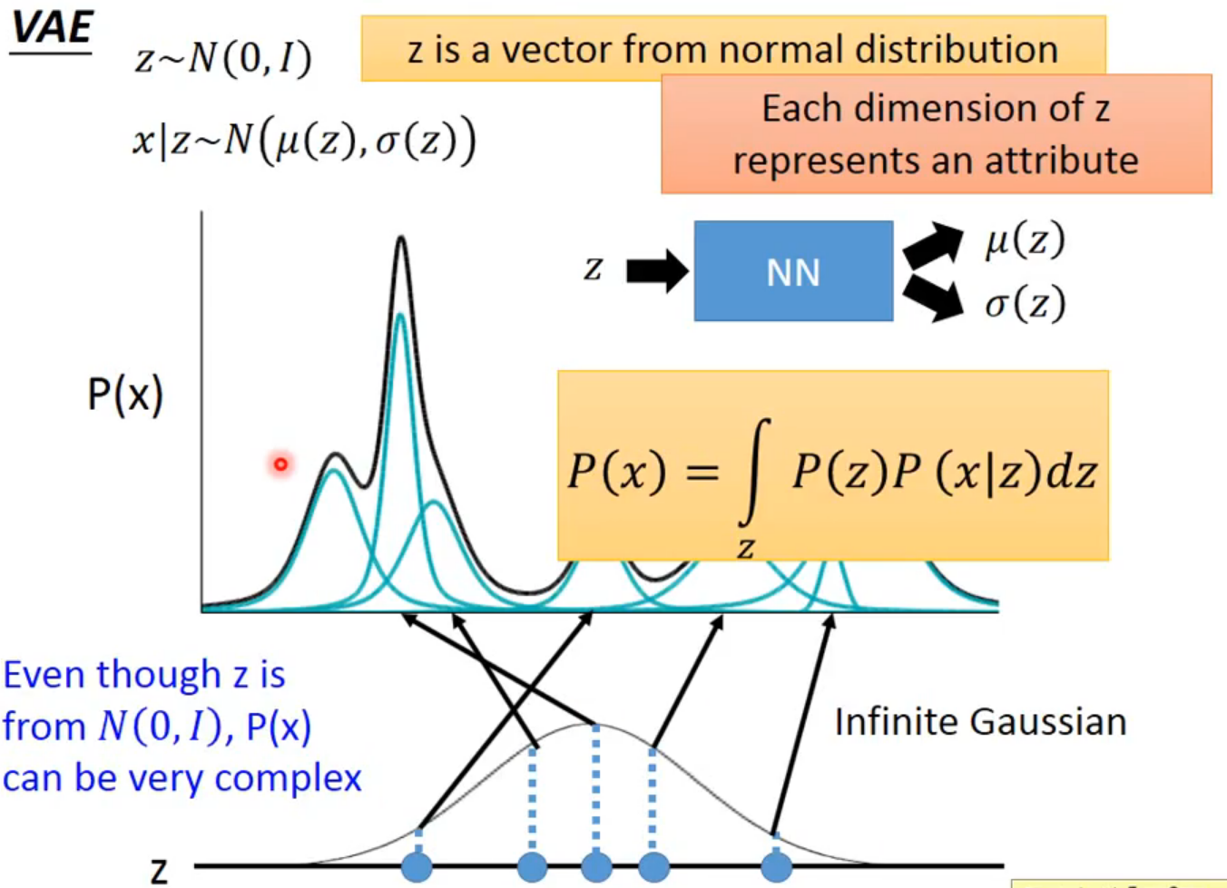
Vatiational Auto-Encoder (VAE)

Slide 11
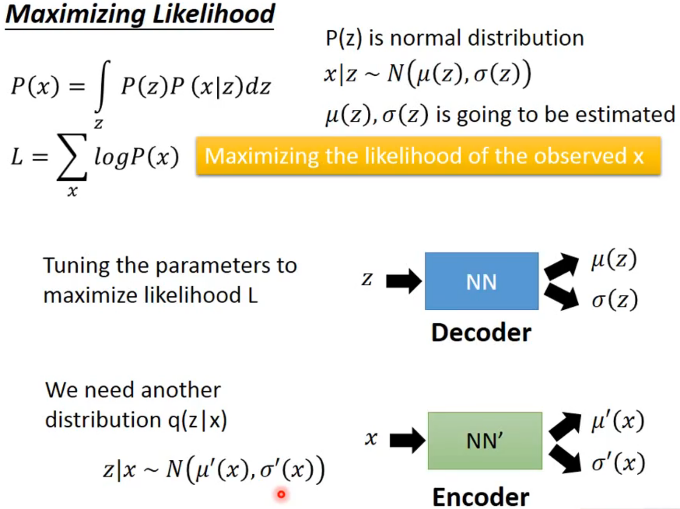
Vatiational Auto-Encoder (VAE)

Slide 12
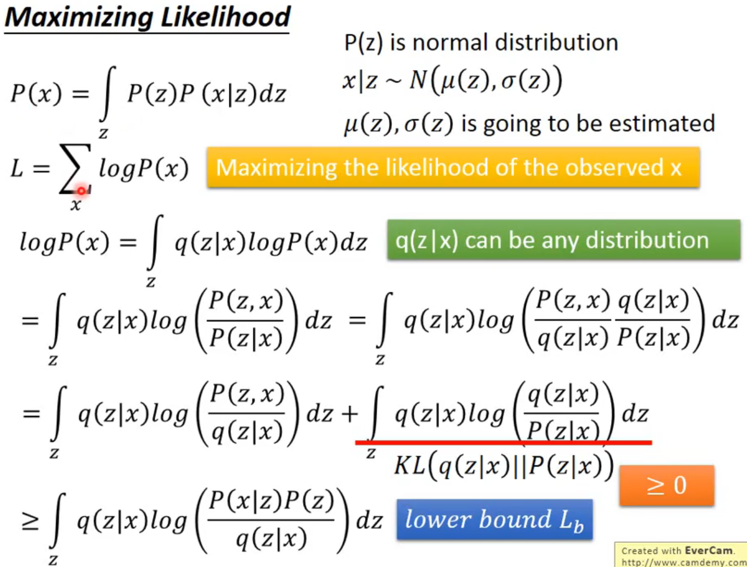
Vatiational Auto-Encoder (VAE)

Slide 13
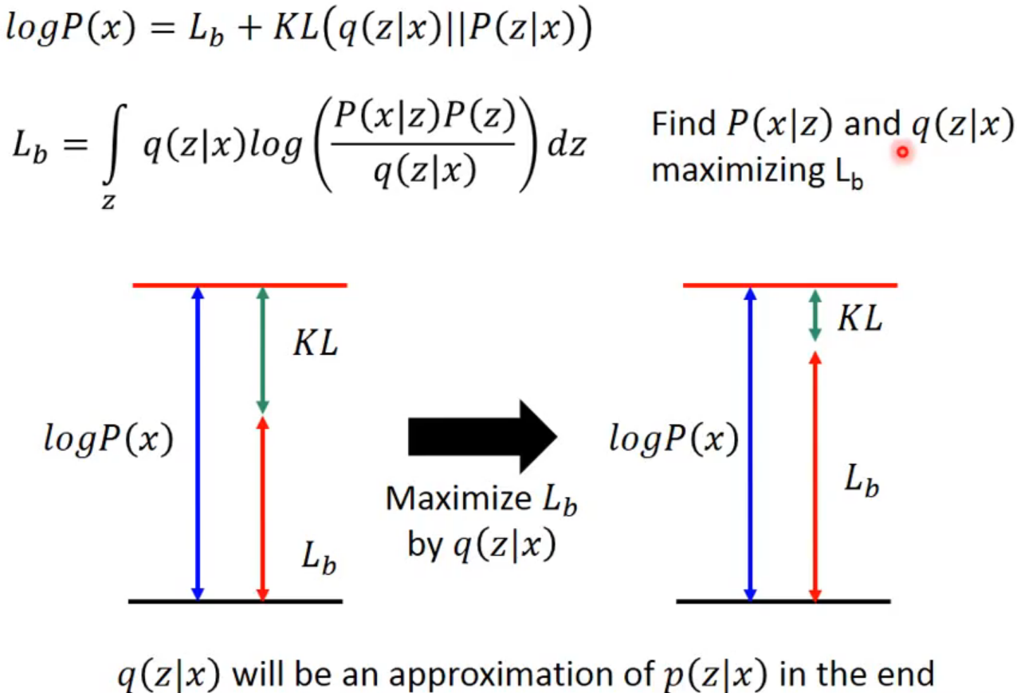
Vatiational Auto-Encoder (VAE)

Slide 14
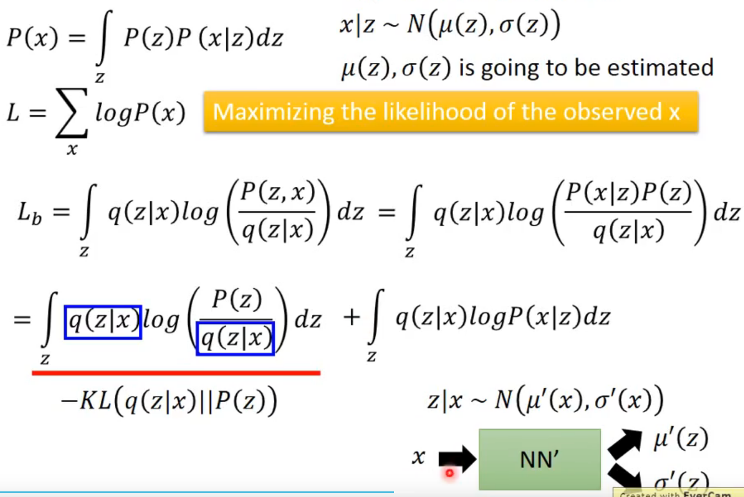
Vatiational Auto-Encoder (VAE)

Slide 15
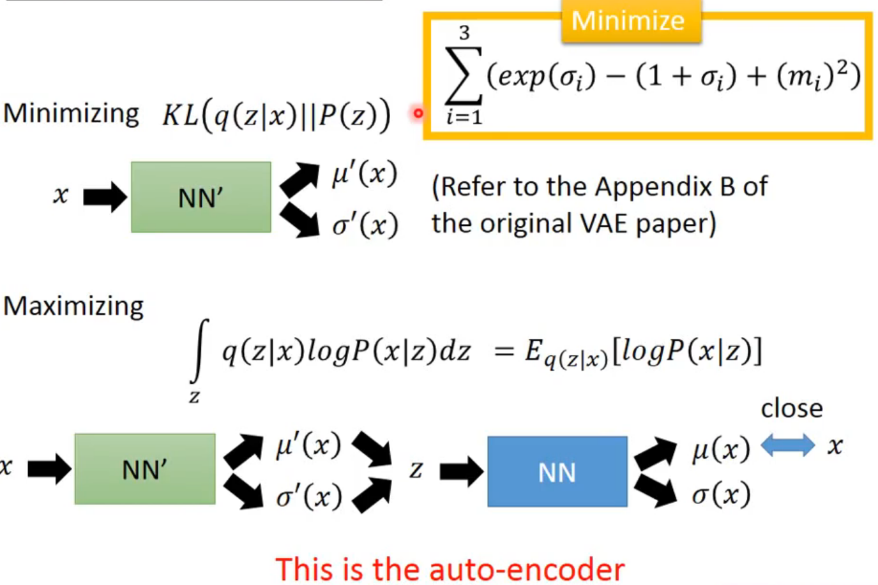
Vatiational Auto-Encoder (VAE)

Slide 16
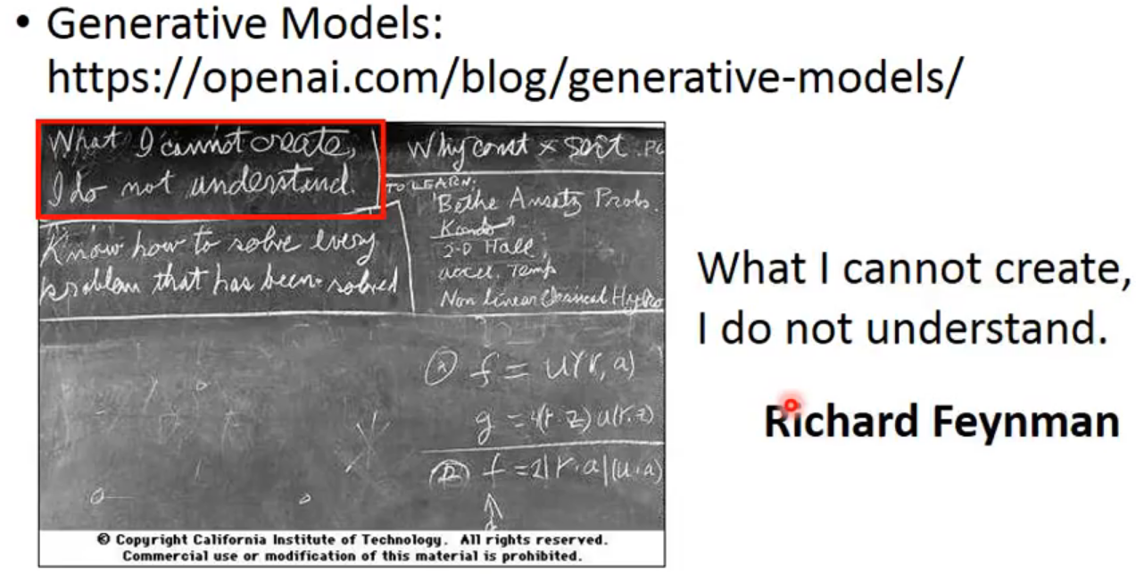
Problem of AE

Slide 17
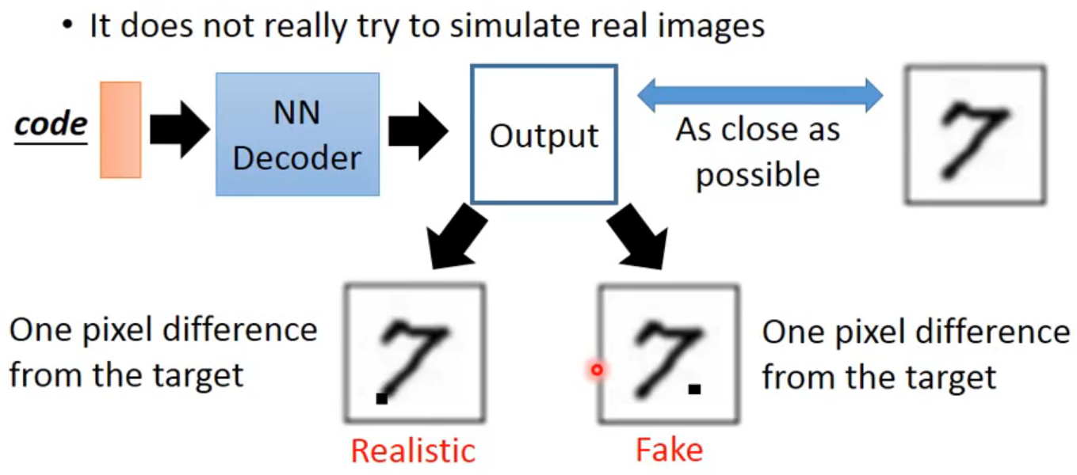
Problem of AE

Slide 18
Problem of AE
AE may just memorize the existing images, instead of generating new images

Slide 19
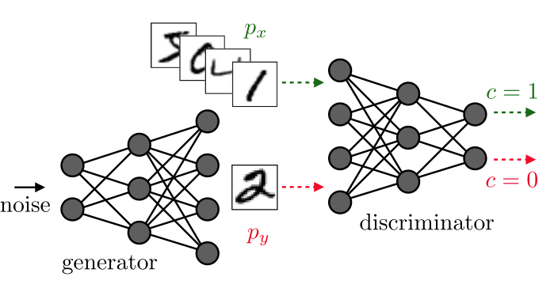
Generative Adversarial Networks (GAN)

Slide 20
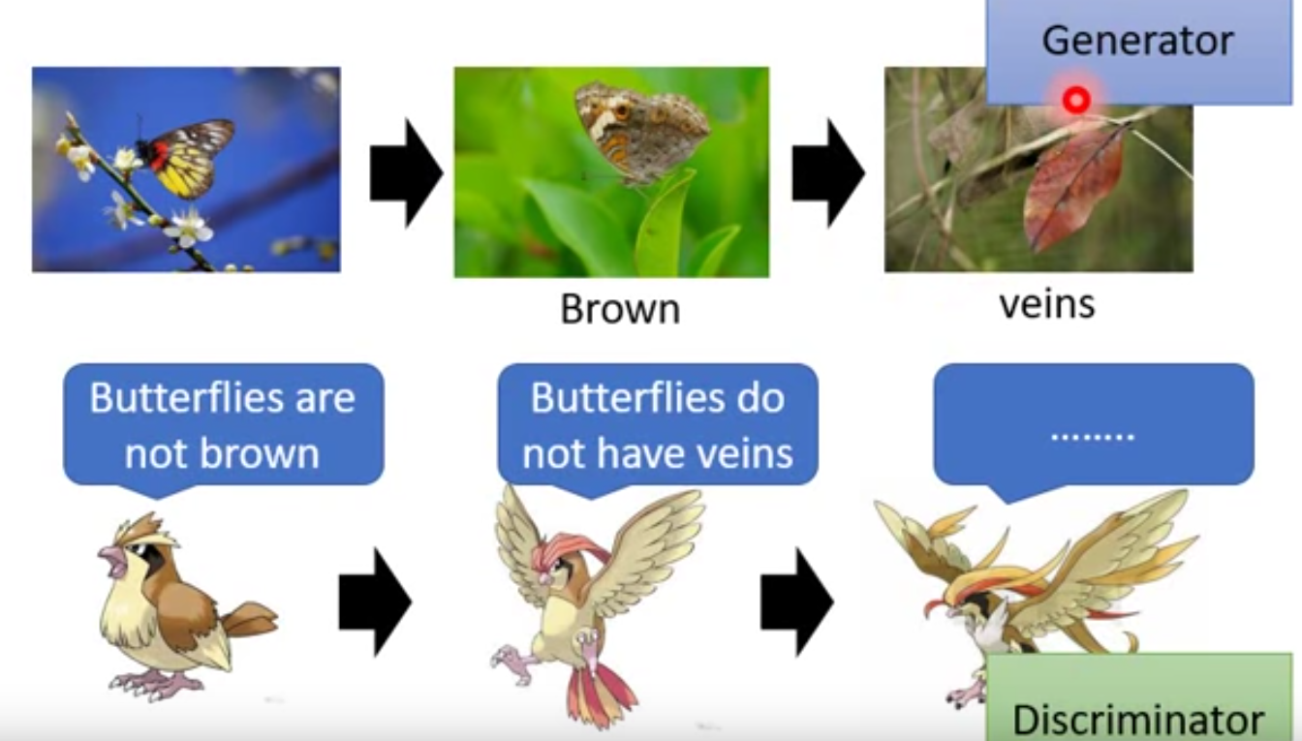
Generative Adversarial Networks (GAN)

Slide 21
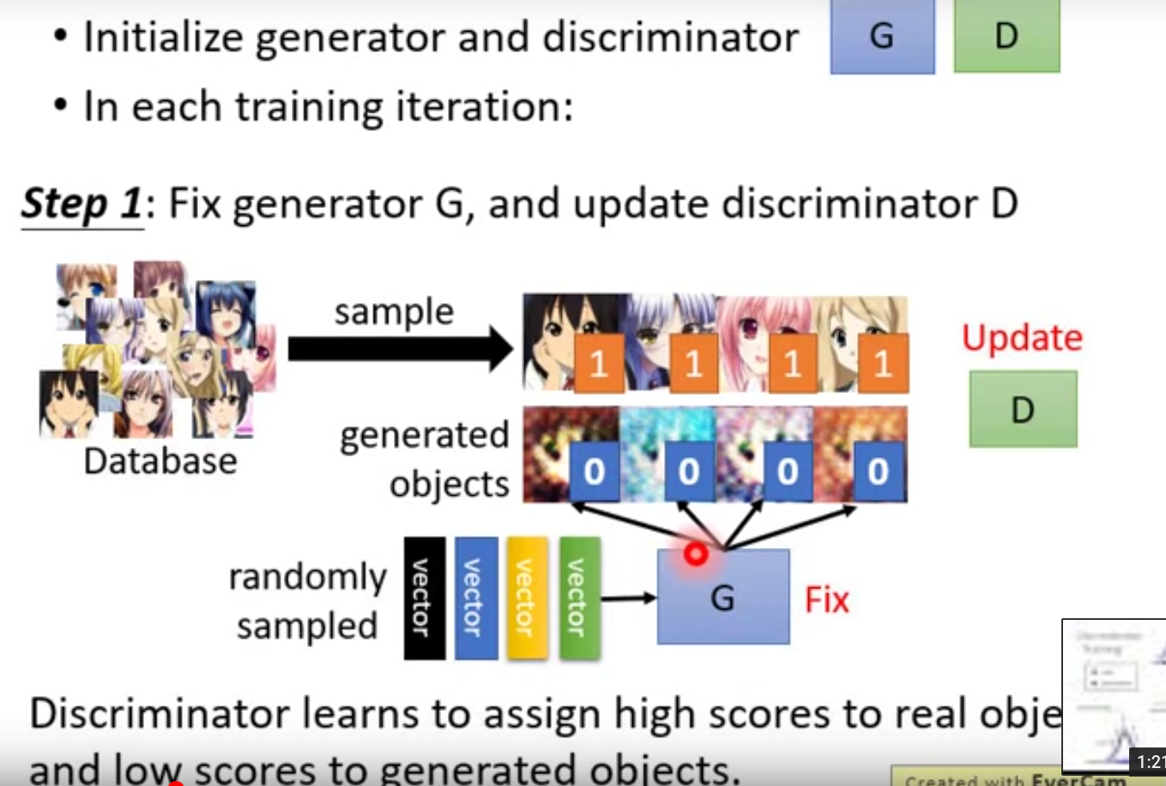
Generative Adversarial Networks (GAN)

Slide 22
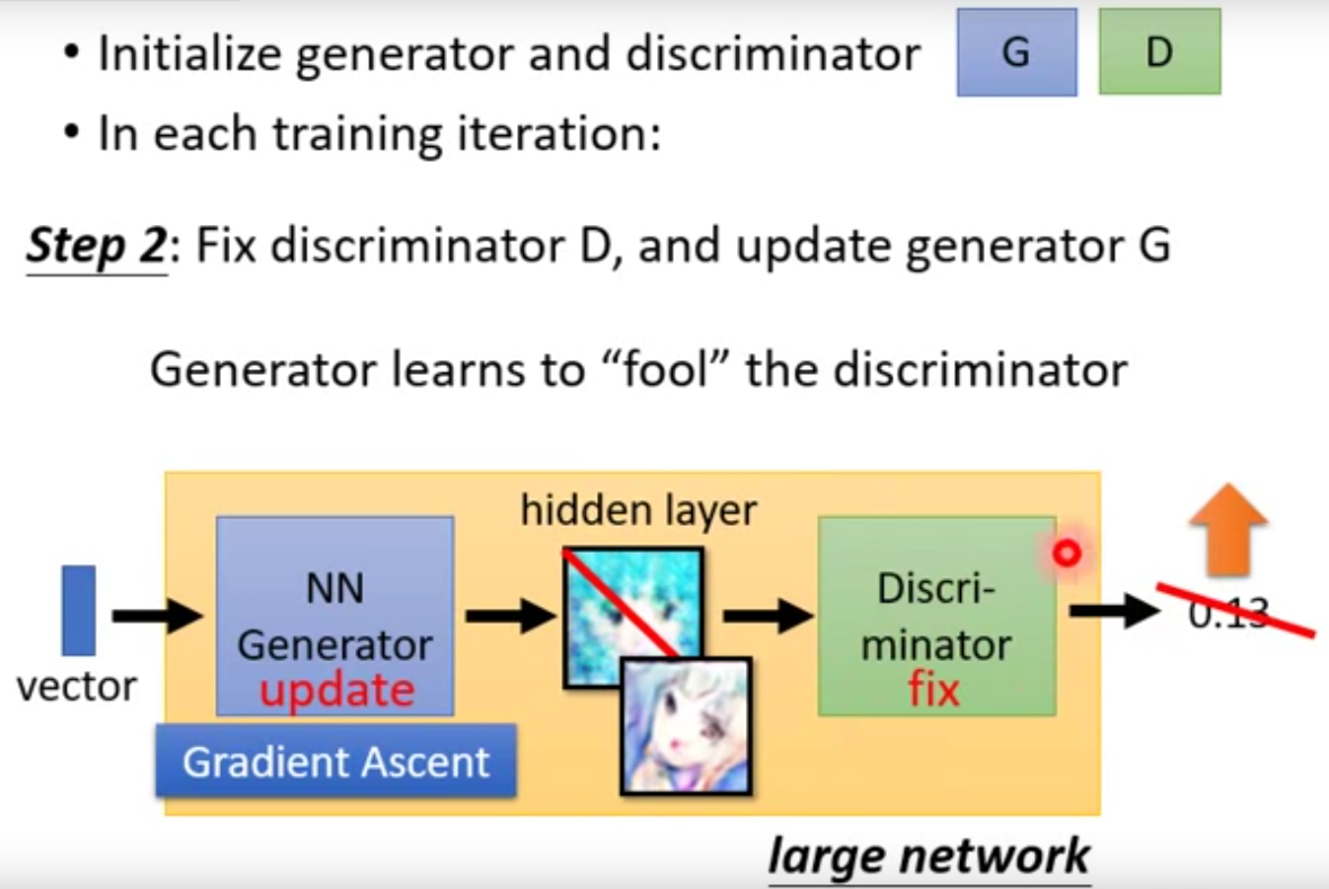
Generative Adversarial Networks (GAN)

Slide 23
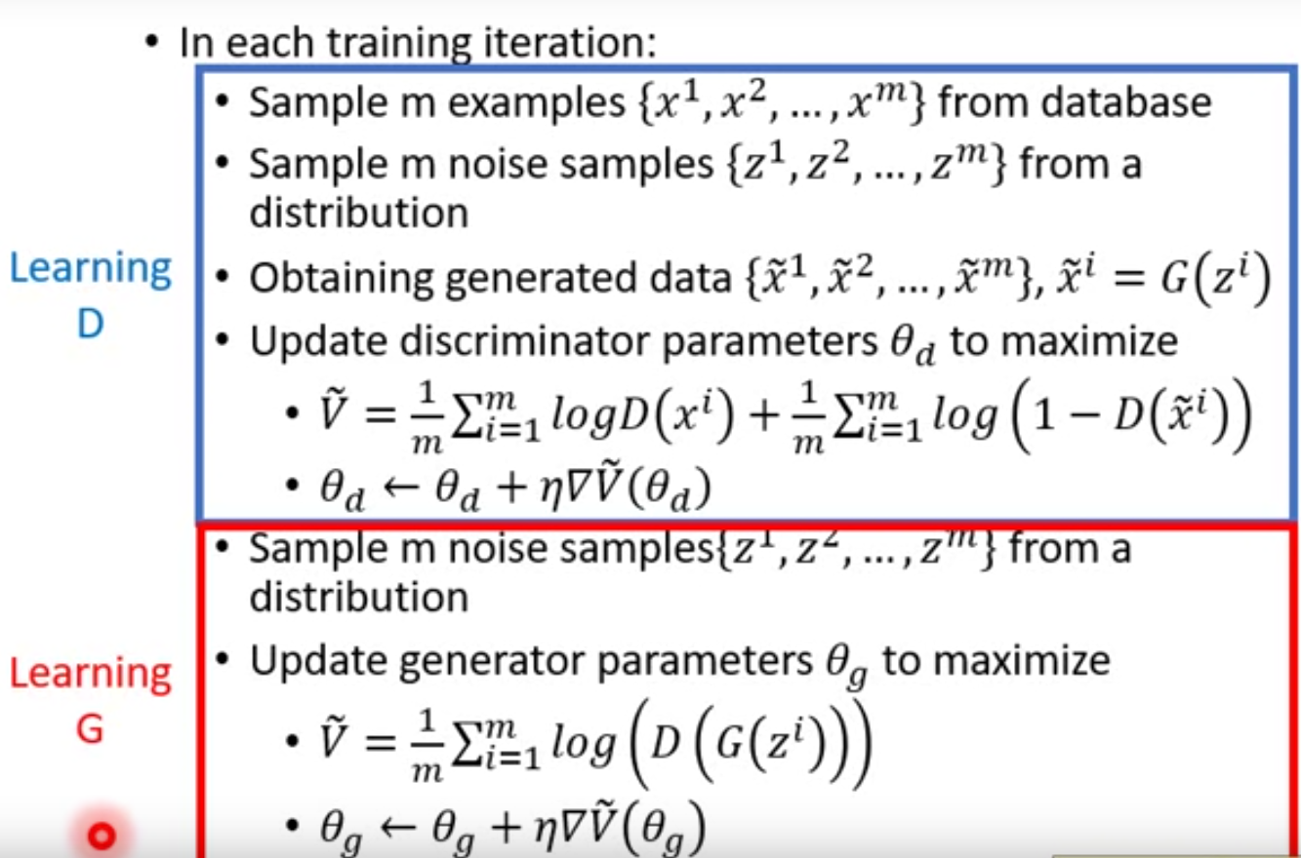
Generative Adversarial Networks (GAN)

Slide 24
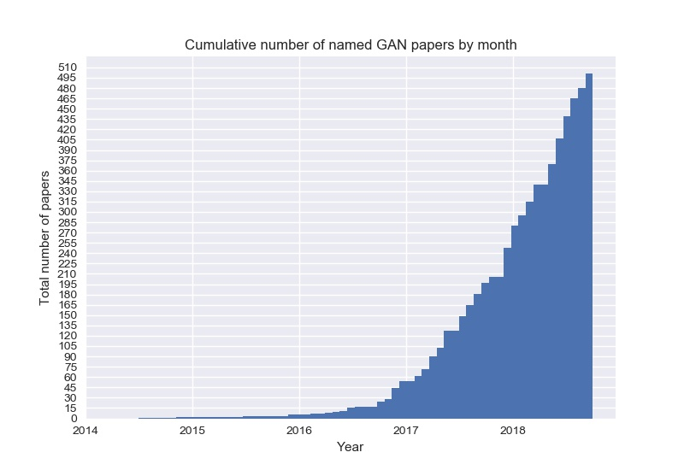
Generative Adversarial Networks (GAN)

Slide 25
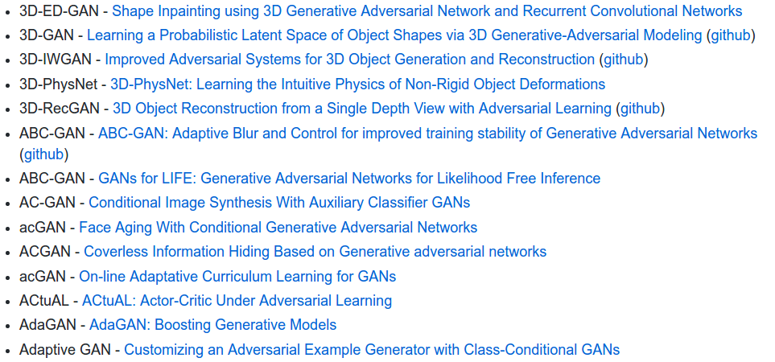
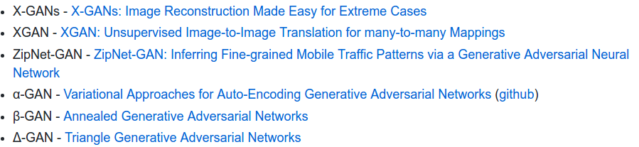
Generative Adversarial Networks (GAN)
https://github.com/hindupuravinash/the-gan-zoo
......

Slide 26
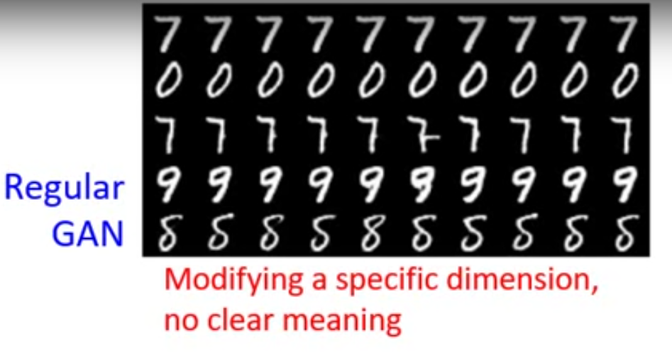
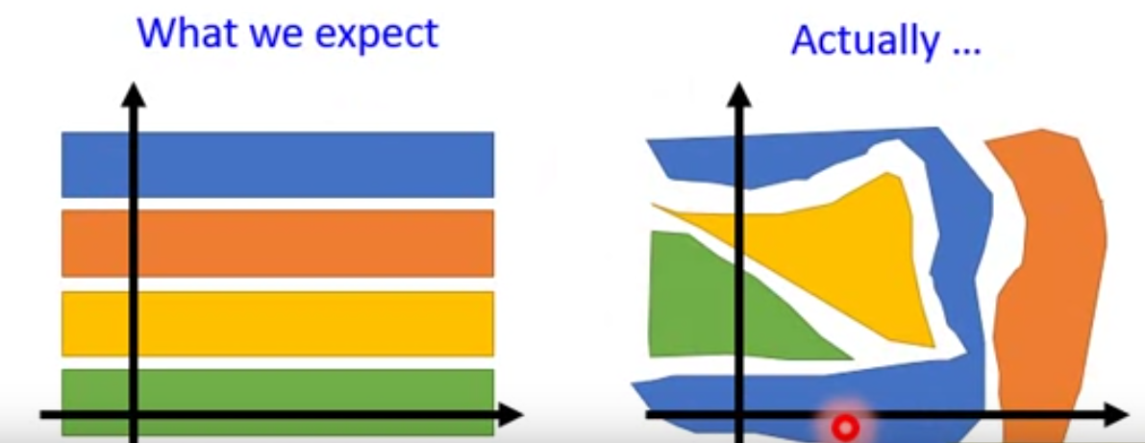
InfoGAN

Slide 27
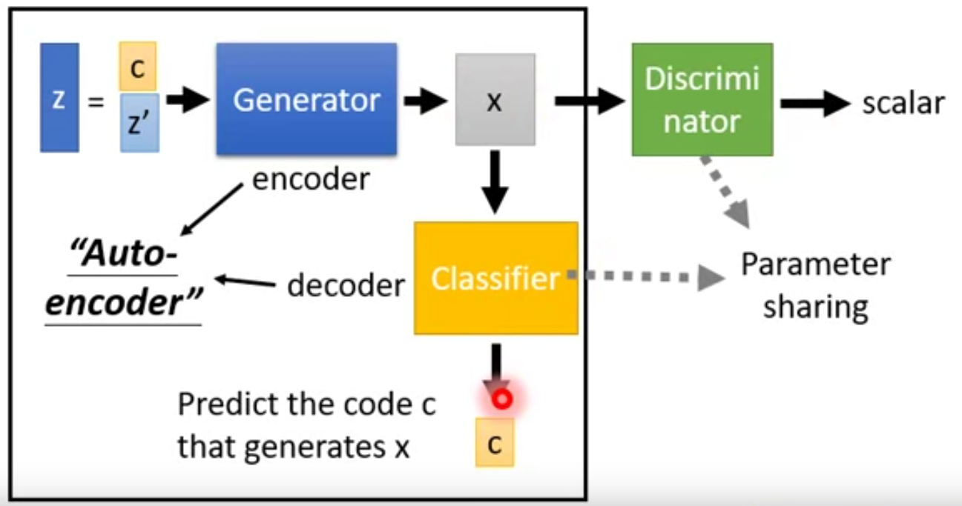
InfoGAN

Slide 28
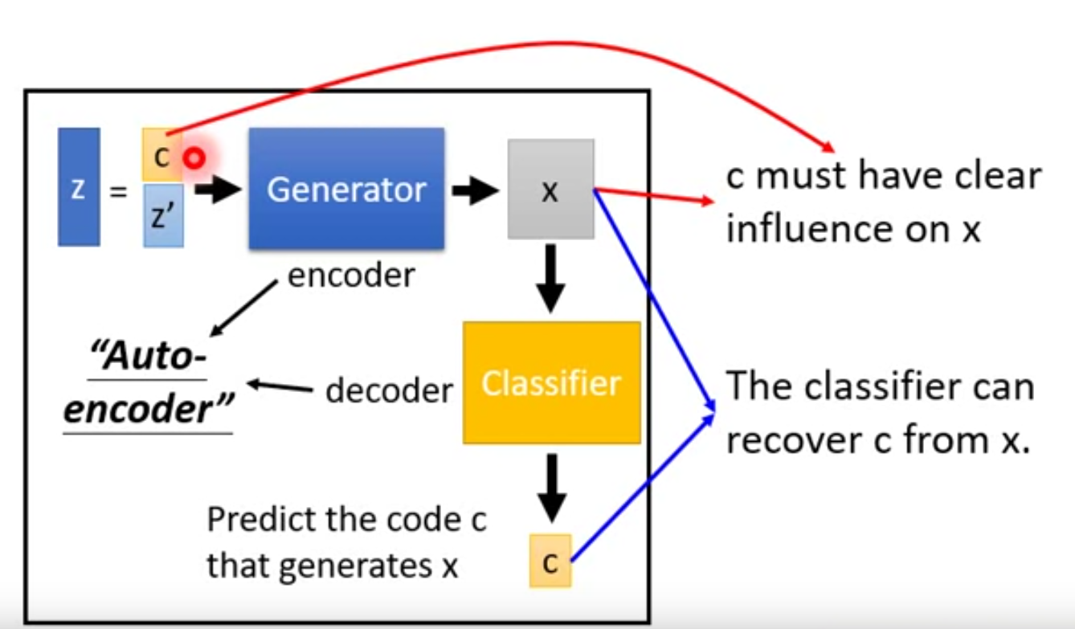
InfoGAN

Slide 29
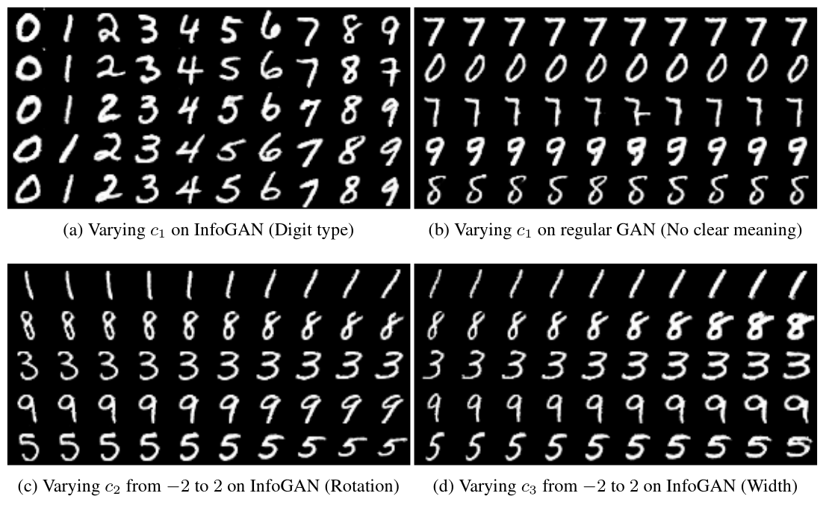
InfoGAN

Slide 30
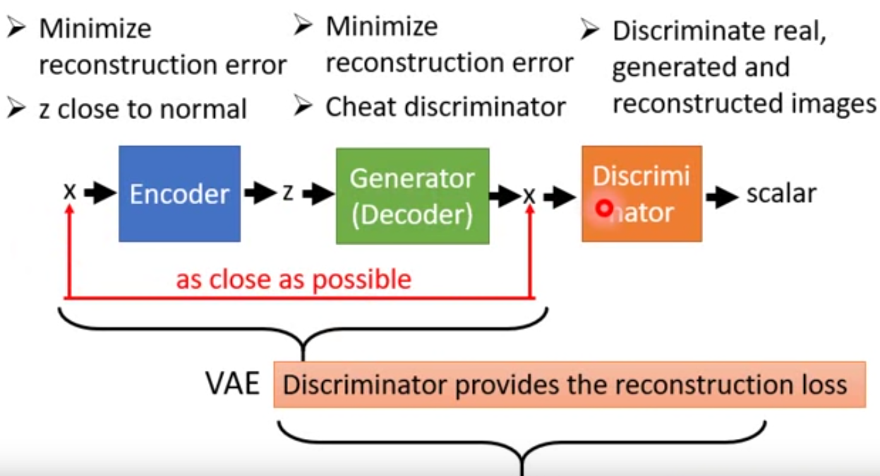
VAE-GAN
GAN

Slide 31
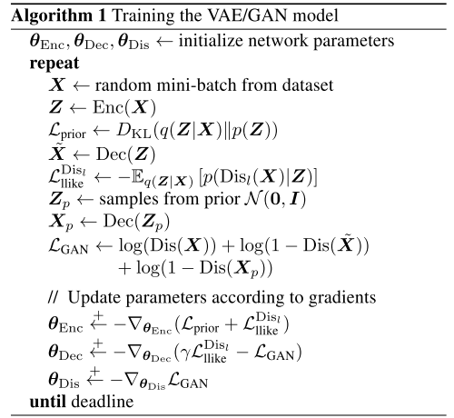
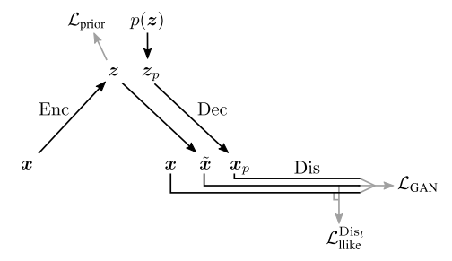
VAE-GAN

Slide 32
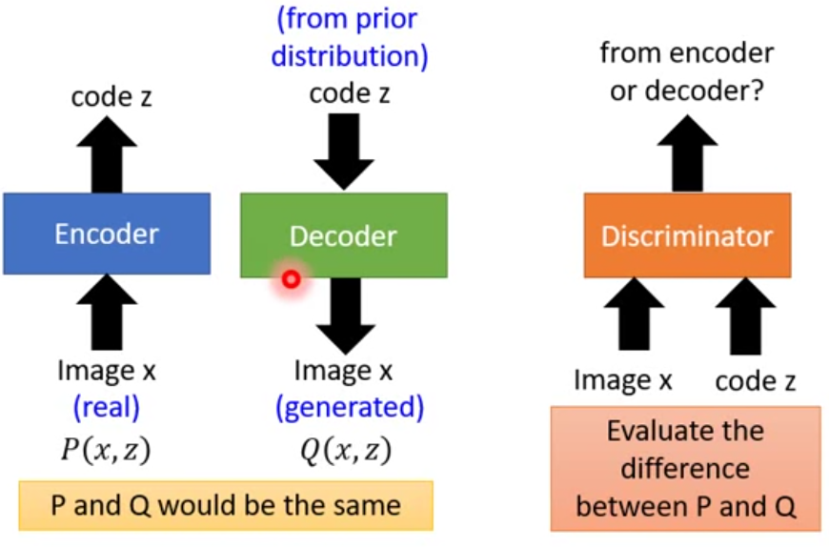
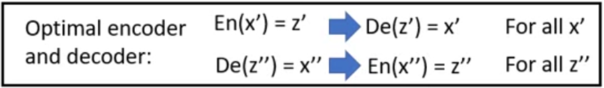
BiGAN

Slide 33
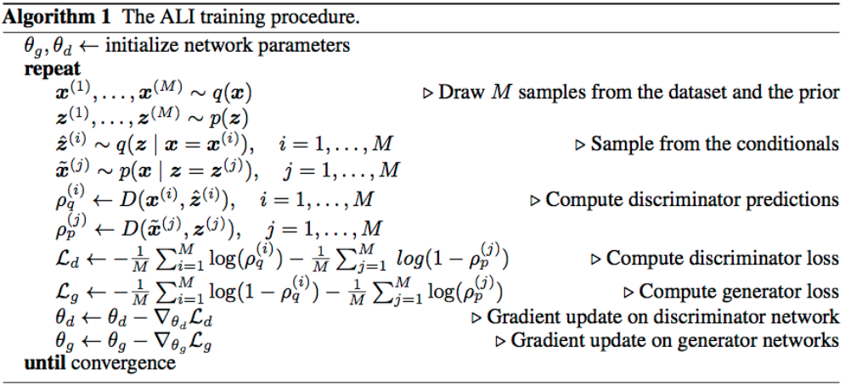
BiGAN

Slide 34
Reference
Tutorial on Variational Autoencoders, https://arxiv.org/pdf/1606.05908.pdf
VAE-GAN paper:Autoencoding beyond pixels using a learned similarity metric, https://arxiv.org/abs/1512.09300
VAE-GAN tensorflow 2.0 code, https://github.com/timsainb/tensorflow2-generative-models/blob/master/6.0-VAE-GAN-fashion-mnist.ipynb
Recent Advances in Autoencoder-Based Representation Learning, https://arxiv.org/abs/1812.05069, nips workshop 2018
InfoGAN: Interpretable Representation Learning by Information Maximizing Generative Adversarial Nets, https://arxiv.org/abs/1606.03657
李宏毅视频，GAN:https://www.bilibili.com/video/av24011528?p=7, Auto-Encoder:https://www.bilibili.com/video/av48285039?p=77. All videos: https://www.youtube.com/channel/UC2ggjtuuWvxrHHHiaDH1dlQ/videos

Slide 35
Thanks.
Q&A

